Slide 1


Qasim “Q” Ijaz
Notes:
This is MBA in one hour. Like any underscoped project, we got this ☺

Slide 2
$whoami
Lead penetration testing teams at Coalfire Labs
“Adaptive penetration testing” instructor at BH U.S. and BH EU
Hundreds of penetration tests
As well as tens of HIPAA and HITRUST assessments
Twitter: @hashtaginfosec

Slide 3
Agenda
Teamwork
Time management
Ethical decision making
Leadership
Communication hacks
Questions

Slide 4
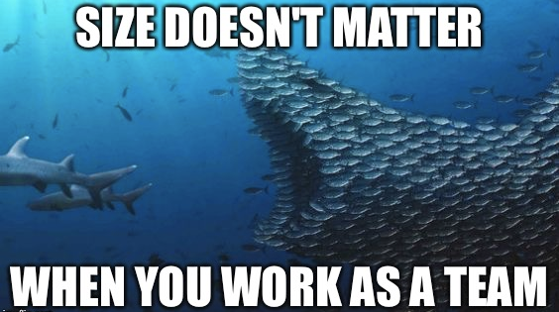

Slide 5
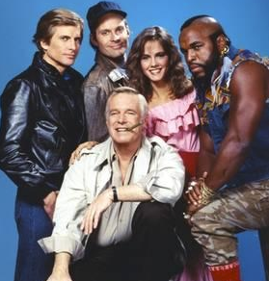
Teams
A collection of people who interact to achieve a common goal
E.g. a project manager, delivery director, and two penetration testers working on an app and network pen test
Teams are part of everyone's life
Different pieces of projects require
Complementary skills and competencies
Coordination of efforts
Establishing priorities
Combining knowledge and expertise
Notes:
We're members of a family team
We’re members of a community team

Slide 6
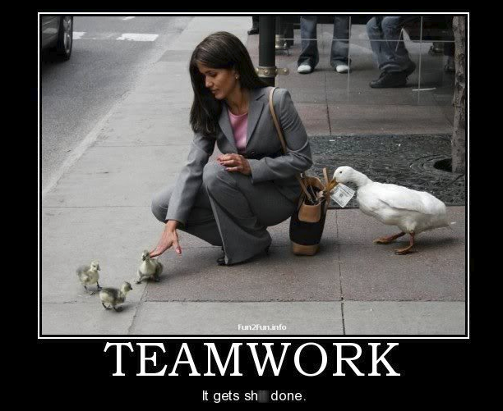
Notes:
Teamwork will lead to lighter workload and reduce duplicate efforts

Slide 7
Enabling Conditions of Great Teamwork
Compelling Direction
That energizes, orients, and engages team members
Reduce confusion, set challenging goals
Strong Structure
Diversity reduces “group think”
Optimally designed processes
Norms that discourage destructive behavior and encourage positive dynamics
Notes:
Result of 40 years of research by
J. Richard Hackman
Professor of Social and Organizational Psychology at Harvard University
Diverse backgrounds result in creativity and avoid “groupthink”
Optimal processes ensure everyone knows their responsibility
Establishing norms gives the team a sense of being “one”

Slide 8
Enabling Conditions of Great Teamwork
Supportive Context
A reward system that reinforces good performance (e.g. bonuses)
An information system that provides access to the data needed for work
Training (internal and external)
Technological assistance
Shared Direction
Fostering common identity and common understanding
Notes:
Supportive Context:
For virtual or geographically diverse teams, providing optimal means of communication is a very important supportive context
Shared Direction:
Distance, diversity, digital dependencies, and changing membership can make teams prone to "us vs them" thinking and incomplete information
Naturally, we're prone to seeing our own subgroup (region, culture, department, etc.) more positively than others
This can be solved by
Developing a shared mindset
Fostering common identity and common understanding
Helps avoid “Lone S.M.E Problem”
Subject matter experts may be dispersed in geographically distant areas
This often leads to individuals withholding information
Solution?
Establish norms to share information e.g. monthly knowledge sharing sessions
Combine SMEs with a new team member on pen test projects
Encourage SMEs to mentor new/aspiring team members
In face to face communication we can pickup on nonverbal and contextual cues
When we walk into a meeting room, we can instantly figure out if everyone looks tired
However, this is not possible through email or instant messaging
What actions can we take to make virtual communication better?

Slide 9
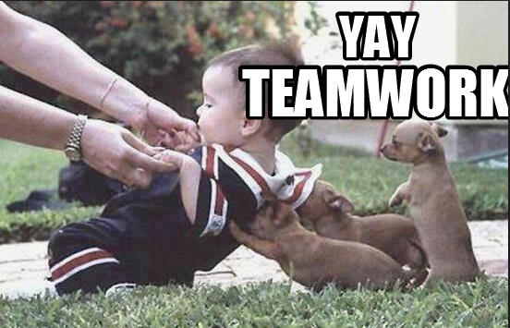

Slide 10
Shred Mindset: How To?
Ensure that each subgroup, team, or team member feels empowered and valued
for their contributions to the team/organization's goals
Create shared experiences
"Structured unstructured time“
Time blocked off in the schedule to talk about matters not directly related to the tasks at hand
Notes:
Shared experiences
Go to a BSides together
Go out for dinner together
Bring team members from one location to another for a few work days
Office/team retreats at a neutral location
Structured Unstructured Time
Could be done through reversing first 5-10 minutes of regularly scheduled meetings for open discussion
Talk about whatever aspects of work or daily life
Can't figure out how to work our new office coffee machine

Slide 11
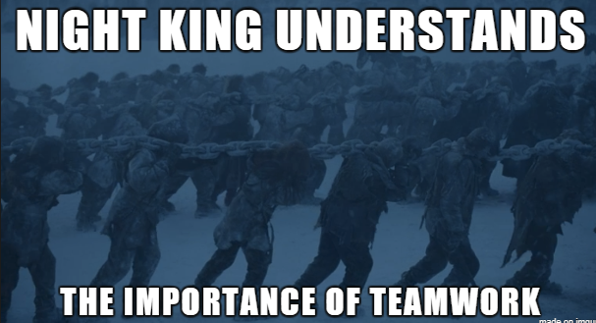

Slide 12
Time Management through Task Management

Slide 13
Accomplish More in Shorter Time
Keep a track of your obligations / tasks
Set and achieve your short and long term goals
Assist with multi-tasking
Reduce and eliminate distractions
Reduce stress ☺
Notes:
Why task management?

Slide 14
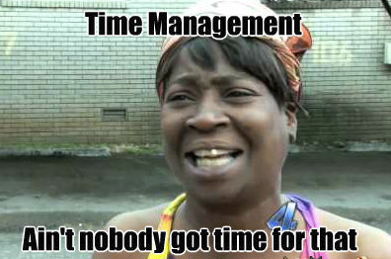
Time Management Through Task management
Notes:
Ms. Wilkins is right. You should manage tasks, not time.

Slide 15
Time Mgmt. Through Task Mgmt.
Instead of fitting work into 8 hours
Think: What tasks I have and how much time per task is required
This will force you to say “No” when necessary
Task management provides us with a sense of accomplishment
Task management is tangible
You can see / communicate your success
Notes:
Think what tasks I have and how much time is required for each task
Tasks are more manageable than time
You have finite time
Tasks are dynamic
Priorities and deadlines can change

Slide 16
Multi-Tasking Like a Pro
Get the big picture
Sequence strategically
Protect yourself
Set and communicate expectations
Document and communicate task status
Working on a task that requires undivided attention?
Set an auto-reply in Outlook/etc. for that time-period
Notes:
Get the big picture and break it into smaller narrow-focus tasks
Sequence tasks strategically
Pick one task and focus on it, rather than juggling
Start with a task that requires utmost concentration and give it your undivided attention
If you must multi-task
Coordinate and group any compatible tasks
E.g., if you know you will need to answer calls at random intervals, work on another task that can interrupted at any time
Protect yourself
Set and communication expectations
Does the task require management approval?
Let the manager know of availability requirements
Working on a task that requires undivided attention?
Set an auto-reply in Outlook for that time-period
Document and communicate task status
“I have started the testing for the day”
“I have completed the testing and have begun writing the report.”
Common status measures: 25%, 50%, 75%, 100%

Slide 17
Task Management toolset

Slide 18
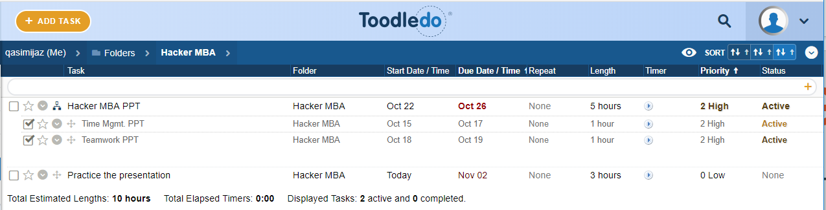
Taming the To-do List
List-based (Try Wunderlist, Todoist, or ToodleDo)
Organize by priority or due date
Prioritize by
Due date
Impact on the bigger picture (project)
Organizational needs (Context/Dependencies)

Slide 19
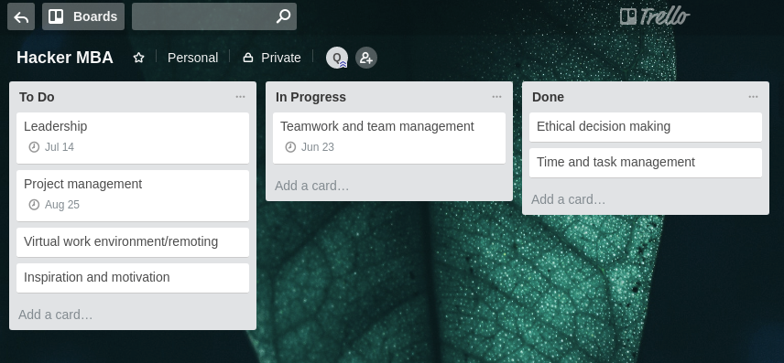
Taming the To-Do List
Kanban (try Trello)
Card/sticky-note based task management
Categorize tasks
To Do, In Progress, Done

Slide 20
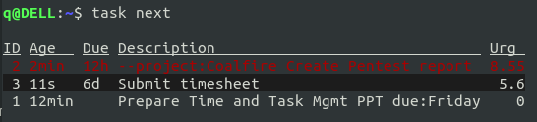
For the Faint of Heart: Command line To-do List
sudo apt install taskwarrior
sudo yum install task
pacman –S task
https://taskwarrior.org/download
Other options: http://todolist.site and http://todotxt.com

Slide 21
Make your to-do list/app work for you
Notes:
Same app or method won’t work for everyone. Use sticky notes, OneNote, rock carvings, or whatever works for you. Try a few methods and you’ll find your soul mate in no time.

Slide 22
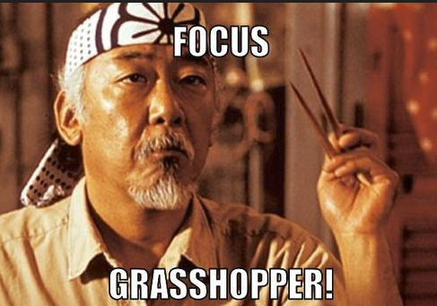
Notes:
Halfway through

Slide 23
Pro Tip: Delegation and Not-to-Do List
Ask yourself how each task already on the list does not contribute to your goals
Does this task really need to be done?
If yes, does it really need to be done by you?
If no, then delegate
If no, create a not-to-do list
I call it "Sometime in the future" list
Any tasks that don't need to be done in near future, go here
This is liberating :)
Notes:
Delegate:
Find someone who is good at this type of task or wants to learn
You will still, possibly, need to QA the final product but it will not take as much time.
In this process, you may end up teaching a teammate something new :)
One day, when you move up the chain, you’ll have someone trained up to take your place ☺

Slide 24
Regain Your Sense of Control by checking off a "Done today" list of accomplishments

Slide 25

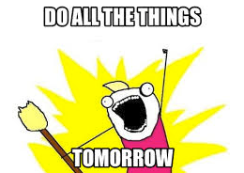
Notes:
Yeah, don’t!

Slide 26
Procrastination Is
“Purely a visceral (primitive), emotional reaction to something we don’t want to do”
Tim Pychyl – author of “Solving the Procrastination Puzzle”
Notes:
Procrastination is not logical, instead it’s the result of the emotional part of our brain.

Slide 27
Beat Procrastination
Seven triggers – reverse them!
Boring
Frustrating
Difficult
Ambiguous
Unstructured
Not essentially rewarding
Lacking in personal meaning
Do Something!
Notes:
Identify and reverse the triggers
Work within your resistance level
Identify what sets off the triggers
Too many application pen tests?
Not enough hardware pen tests?
Do something
Anything to get started
It is easier to keep going once you start something
Document the costs of procrastination
Reward yourself for doing the work
Disconnect from social media, email, and/or texting

Slide 28
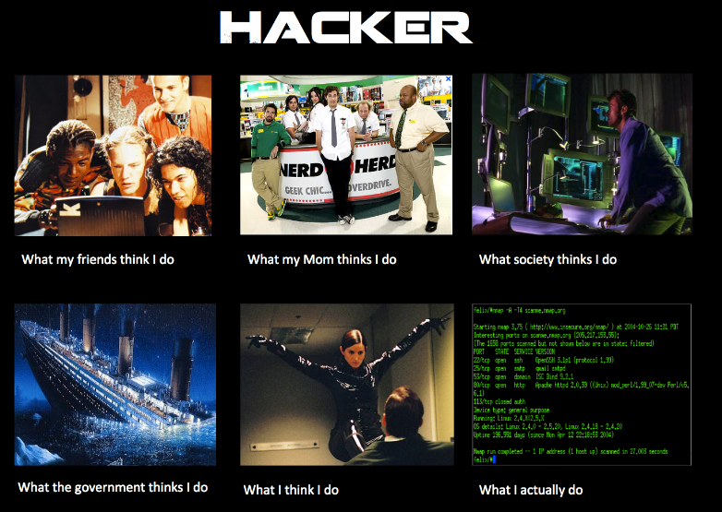
Notes:
Yeah, don’t!

Slide 29
Ethical Decision Making

Slide 30
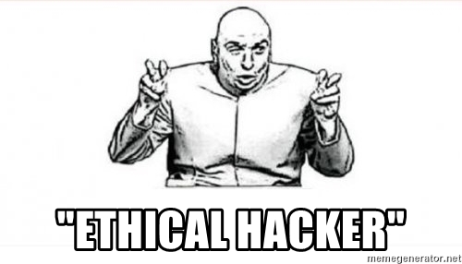
Notes:
Yeah, don’t!

Slide 31
Why “Ethical” Hacking: No Right or Wrong Answers
Do you do the right thing for the client (whole company) or their staff (individual)
Do you report the names of individuals who fell for social engineering?
What if its their first job and first day on the job?
Do you stick with specific scope even if a Windows Server 2000 box has open RDP port outside of your external network scope?
In heat of the moment, Associate Consultant, first day on the job, kicks off a Nessus scan against a segment outside the scope of the engagement
How do you report this incident to the client?
Who takes the responsibility?
Notes:
These are “Dilemmas of Ethical Hacking”

Slide 32
Solving Right vs. Wrong
Can be solved using scientific approach to problem solving
Artifacts from a previous possible breach found on client systems
Teammate stealing sensitive data from client systems and selling it to APT 28
Develop a Solution
Define the Problem
Scientific Approach to Problem Solving
Conduct Analysis
Formulate a Hypothesis
Gather Facts
Notes:
APT28 is a Russian cyber espionage group

Slide 33
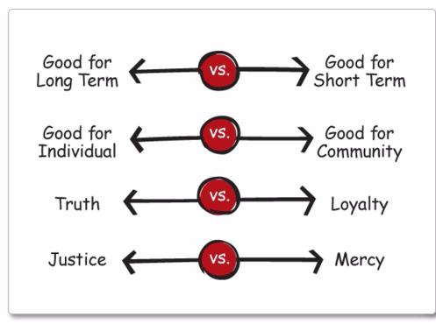
Right vs. Right
Notes:
Right vs Right on the other hand is complicated
To solve right vs. right decisions, we can use Professor Joseph L. Badaracco’s right vs. right framework.

Slide 34
4 Steps to Ethical Decision Making
Pick a plan that does most good and least harm
a.k.a Utilitarianism
Does it best serve other’s rights, including shareholders' rights?
Can I live with it? Is it consistent with our basic values and commitments?
Is it feasible in the world as it is?
Notes:
So, after gathering all the facts you’ve made a decision that is legal. Now how do you evaluate if it is an ethical decision? Use these four steps.
Imagine that your plan will be published tomorrow. What would you like to see in print?

Slide 35

Leadership through Extreme Ownership
Notes:
https://www.amazon.com/Extreme-Ownership-U-S-Navy-SEALs-ebook/dp/B00VE4Y0Z2

Slide 36
Leadership
Everyone here is a leader
Engagement Leads
Mentors
Researcher or blog post writer
Leading a team of 1 or many
There are no bad teams
There may be challenging teams
Lead by example
“Let me show you how to do it efficiently”
Inspire, don’t require
Don’t be Bill Lumbergh
Notes:
When you come across a bad team, look at its leader and how they’re leading and handling the team. When you come across a challenging team, it might often requires a change in how they are lead.
Don’t be Bill from office space.

Slide 37
Extreme Ownership
Explain the “Why” behind the decision
Get good at “information sharing”
Communicate upward and downward
“Prioritize and execute”
Not all problems require the same priority
Delegate when you don’t need to know personally
But avoid “Improvement overload”
Keep it simple
Avoid complexity like a plague!
Notes:
Teams often get tangled into buzz words like mindfulness and thought leadership and forget their true values. Don’t jump to improvement overload. Instead, lead small changes.

Slide 38
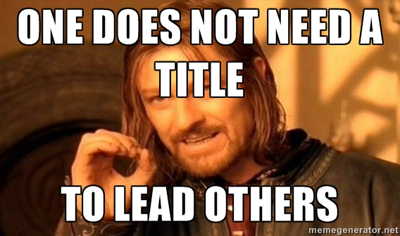
Notes:
Yeah, don’t!

Slide 39
Effective Written & Verbal Communication

Slide 40
Email Communication
Avoid contracted forms
Do not > don’t
We’ll < We will
Provide context
Don’t just assume the recipient knows what you are talking about
Provide detail but avoid verbosity (-v > -vvv)
Use bullet points where necessary
Start the email with important information
Title says it all
Subject: Please Respond – Change of Scope
Email == FYI
Call == I need this urgently
Notes:
If the client hasn’t responded to your email in due time and you are falling behind on the project, please call the client.
If you expected a response to your email the same day, the subject should’ve said so

Slide 41
Conference Calls
Let the organizer know if you cannot attend
Have a good reason if it’s a client call
For client calls
Review any documents beforehand
Write down questions or bullet points you’ll need to discuss
Be semi-formal
Use the “Mute” button ☺
Use an Agenda!
Every call has a “leader”
The call lead (e.g. PM) should ensure every topic gets its due time
Notes:
Your delivery or project managers can’t do their job if you skip calls
Missing calls with clients shows you do not value their time and money ☺

Slide 42
Thanks twitter: @hashtaginfosec
Notes:
I’ll be around to answer any questions you may have

